Slide 1
Example quadrats
Expanded

Slide 2
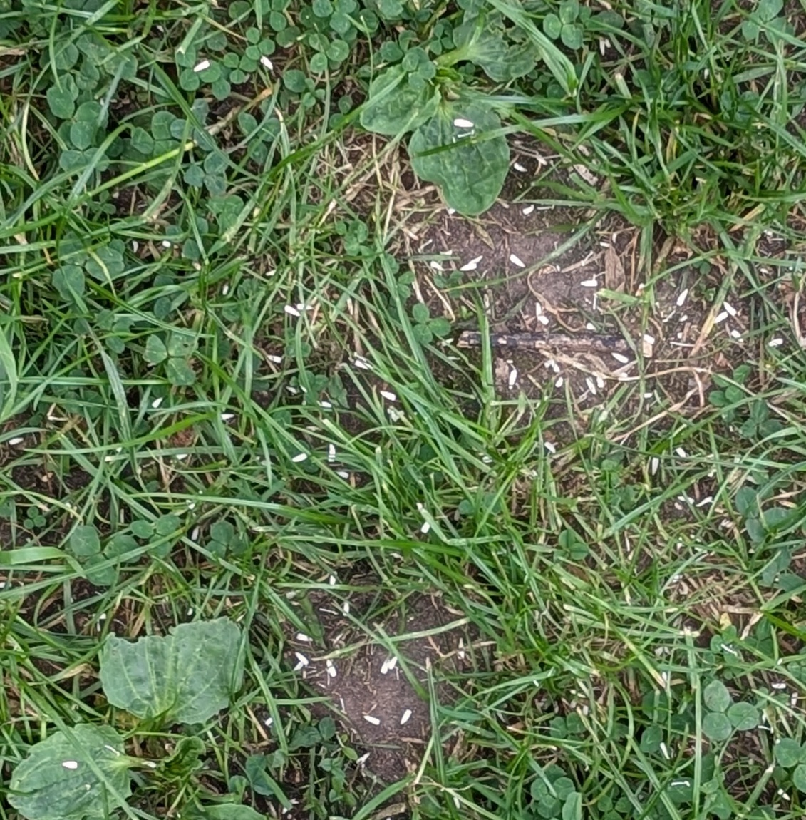
Quadrat 1

Slide 3
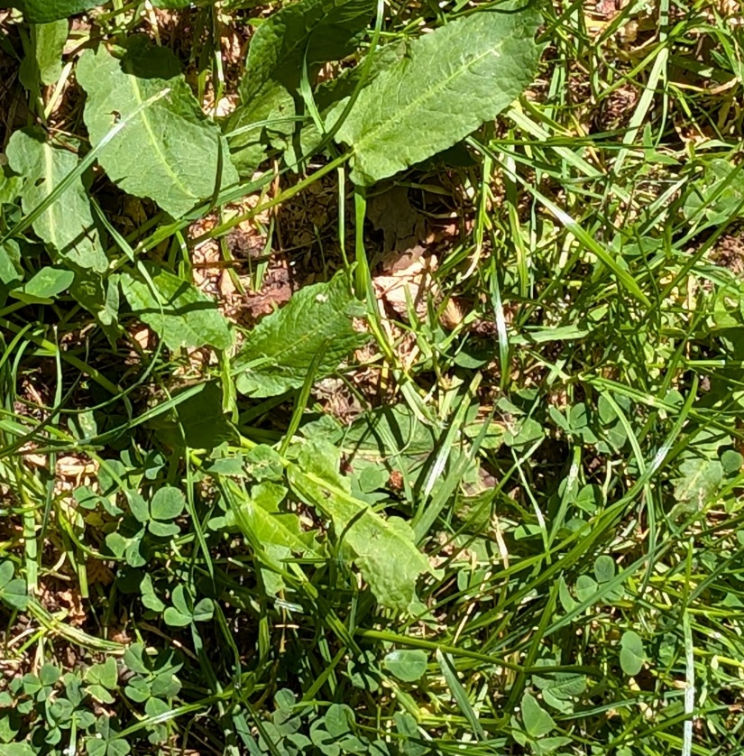
Quadrat 2

Slide 4
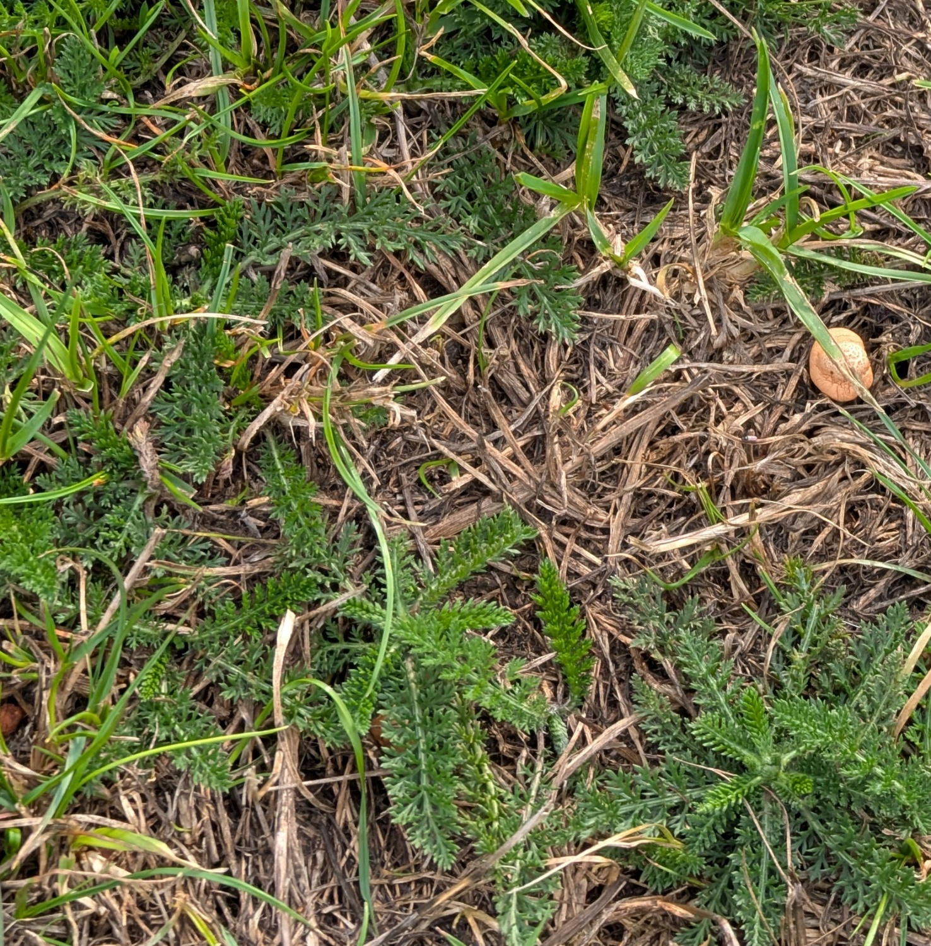
Quadrat 3

Slide 5
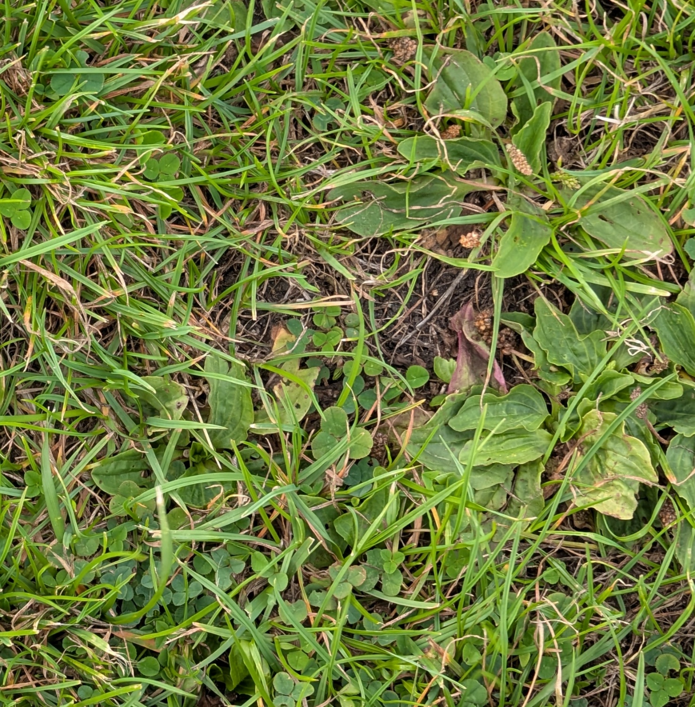
Quadrat 4

Slide 6
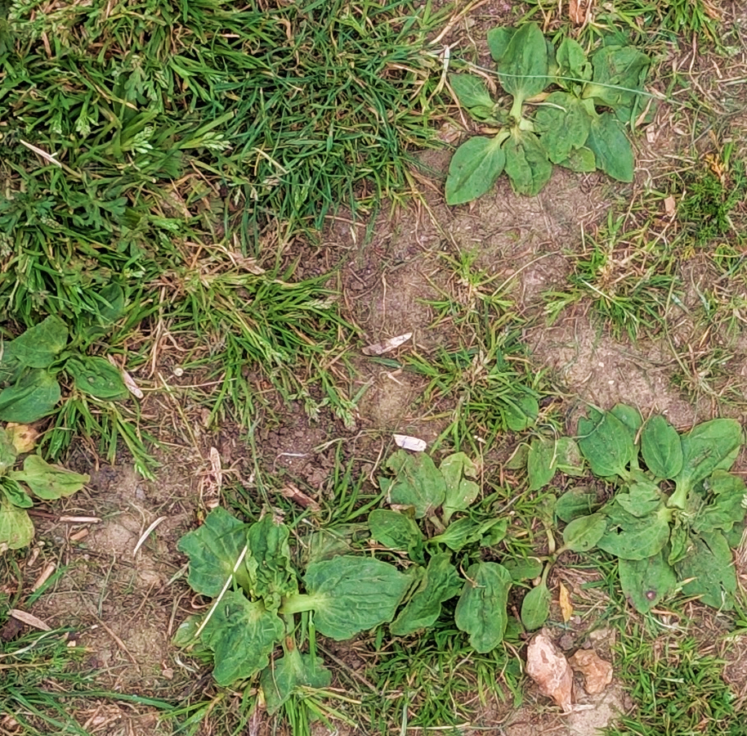
Quadrat 5

Slide 7
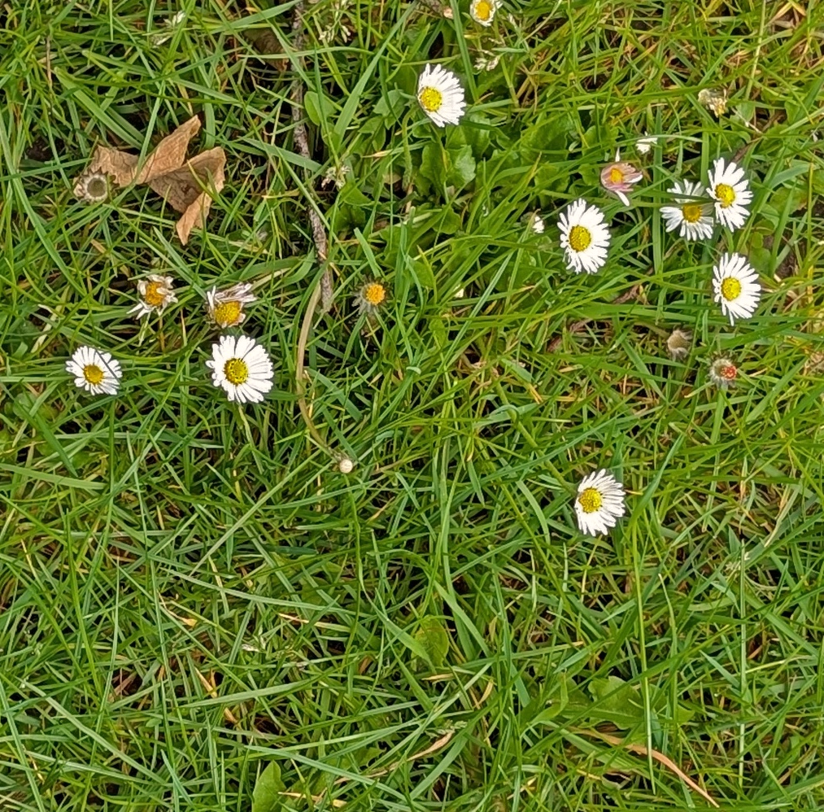
Quadrat 6

Slide 8
Practice surveys

Slide 9
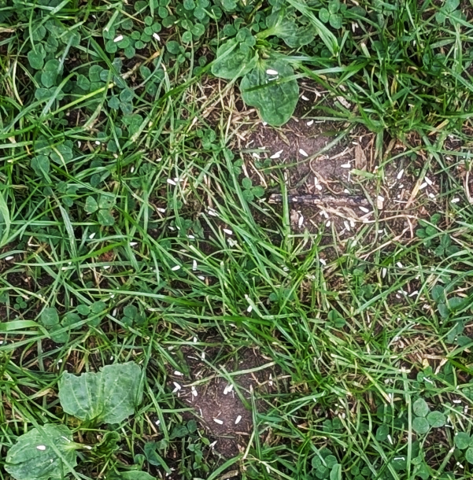

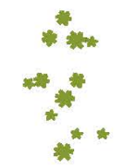
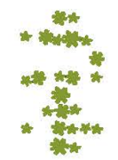
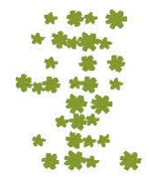
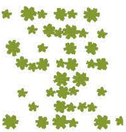
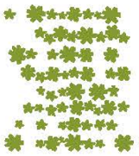
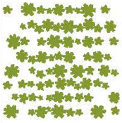
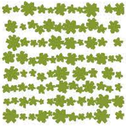
Quadrat 1
 | Present? | 1-4% | 5-10% | 11-25% | 25-33% | 34-50% | 50-75% | 75-90% | 91-100%
Grass
Clovers
Greater plantain
Broad-leaved dock
Common daisy
Dandelion
Common mouse-ear
Yarrow
Yellow rattle

Slide 10
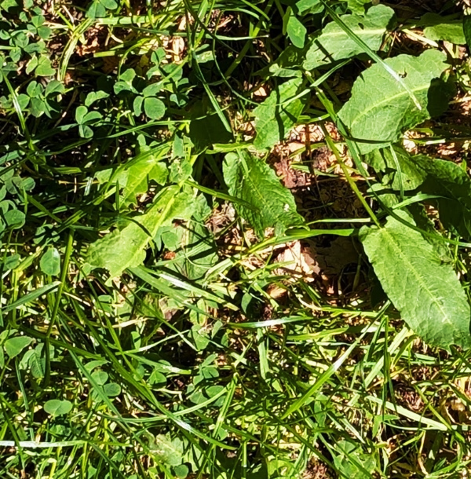
Quadrat 2
 | Present? | 1-4% | 5-10% | 11-25% | 25-33% | 34-50% | 50-75% | 75-90% | 90-100%
Grass
Clovers
Greater plantain
Broad-leaved dock
Common daisy
Dandelion
Common mouse-ear
Yarrow
Yellow rattle

Slide 11
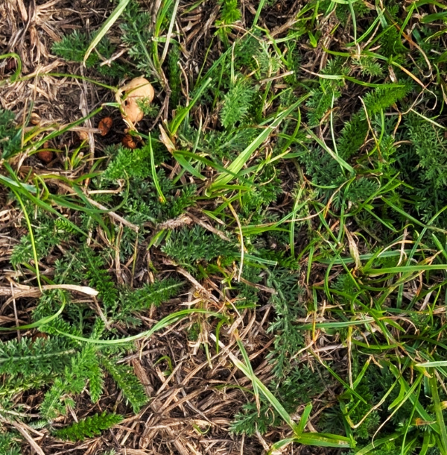
Quadrat 3
 | Present? | 1-4% | 5-10% | 11-25% | 25-33% | 34-50% | 50-75% | 75-90% | 90-100%
Grass
Clovers
Greater plantain
Broad-leaved dock
Common daisy
Dandelion
Common mouse-ear
Yarrow
Yellow rattle

Slide 12
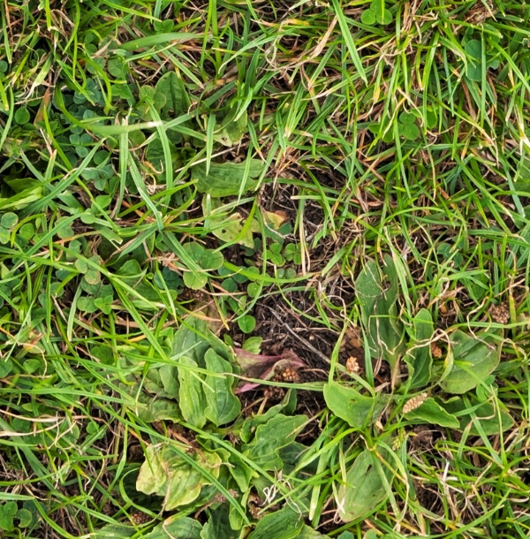
Quadrat 1
Quadrat 4
 | Present? | 1-4% | 5-10% | 11-25% | 25-33% | 34-50% | 50-75% | 75-90% | 90-100%
Grass
Clovers
Greater plantain
Broad-leaved dock
Common daisy
Dandelion
Common mouse-ear
Yarrow
Yellow rattle

Slide 13
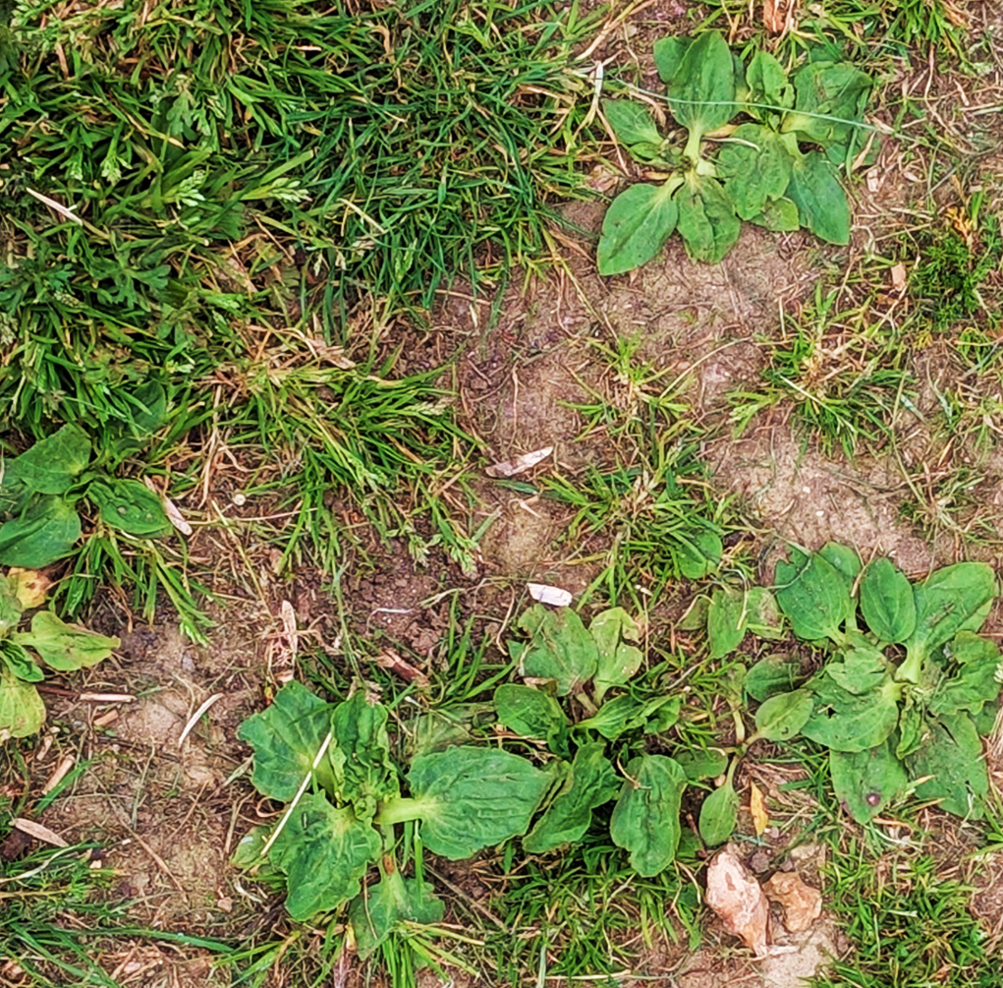
Quadrat 1
Quadrat 5
 | Present? | 1-4% | 5-10% | 11-25% | 25-33% | 34-50% | 50-75% | 75-90% | 90-100%
Grass
Clovers
Greater plantain
Broad-leaved dock
Common daisy
Dandelion
Common mouse-ear
Yarrow
Yellow rattle

Slide 14
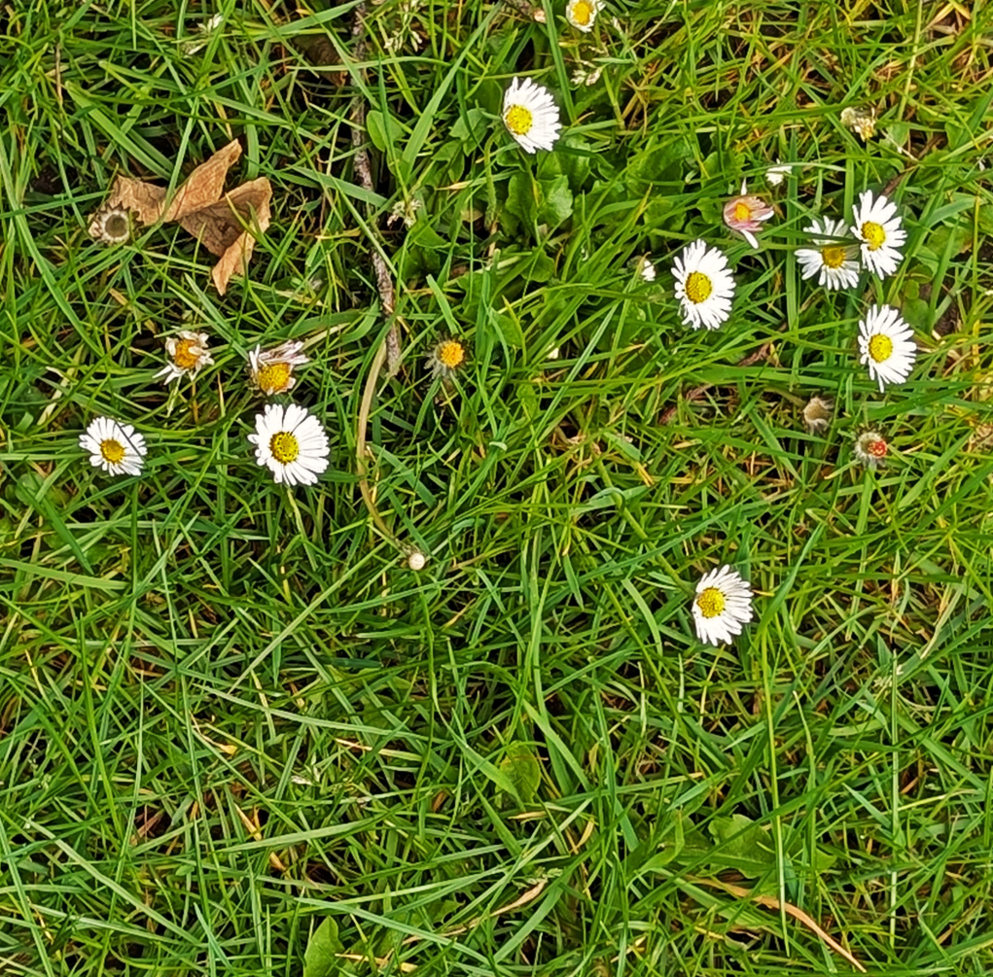
Quadrat 1
Quadrat 6
 | Present? | 1-4% | 5-10% | 11-25% | 25-33% | 34-50% | 50-75% | 75-90% | 90-100%
Grass
Clovers
Greater plantain
Broad-leaved dock
Common daisy
Dandelion
Common mouse-ear
Yarrow
Yellow rattle

Slide 15
Answers and interpretations
Note:
Sometimes the area covered by a species will be close to the borderline between two categories, leading to differences in estimations. Try to have group members independently estimate the area, then compare.
In the fields, taking many samples is one way of mitigating this type of error.

Slide 16
Quadrat 1
Grass is less than 10cm, and Greater Plantains are growing flat to the ground, suggesting the area is regularly cut.
Greater Plantain and bare patches indicate the soil is compacted. This area is probably walked on often.
 | Present? | 1-4% | 5-10% | 11-25% | 25-33% | 34-50% | 50-75% | 75-90% | 90-100%
Grass |  |  |  |  |  |  |  | x
Clovers |  |  |  |  | x
Greater plantain |  |  |  | x
Broad-leaved dock | no
Common daisy | no
Dandelion | no
Common mouse-ear | no
Yarrow | no
Yellow rattle | no
Notes:
Grass is relatively short, and greater plantains are growing flat to the ground, suggesting the area is regularly cut.
Greater plantain and bare patches indicate the soil is compacted. This area is probably walked on often.

Slide 17
Quadrat 2
Dock indicates soil nutrient levels might be high.
Grass is 11-30cm, some dock leaves look damaged, others don’t. This area is probably not regularly mown or walked on.
This might be a good area to add more grassland plants and boost biodiversity. However, the potentially high nutrient levels mean some slower-growing plants might not be able to compete with the grass.
 | Present? | 1-4% | 5-10% | 11-25% | 25-33% | 34-50% | 50-75% | 75-90% | 90-100%
Grass |  |  |  |  |  |  | x
Clovers |  |  |  |  |  | x
Greater plantain | no
Broad-leaved dock |  |  |  |  | x
Common daisy | no
Dandelion | no
Common mouse-ear | no
Yarrow | no
Yellow rattle | no
Notes:
Dock indicates soil nutrient levels might be high.
Grass is longer, dock leaves some dock leaves look damaged, others don’t. This area is probably not very regularly mown or walked on.
This might be a good area to add more grassland plants and boost biodiversity. However, the potentially high nutrient levels mean some slower-growing plants might not be able to compete with the grass.

Slide 18
Quadrat 3
Yarrow leaves and grass are shorter than 10cm indicates the area is likely to be frequently mown.
Yarrow is tolerant of dry conditions
Lots of dry yellow grass might be an indication of compaction, but it may also be due to dry weather. Information from other survey quadrats might give a clearer picture of the conditions.
 | Present? | 1-4% | 5-10% | 11-25% | 25-33% | 34-50% | 50-75% | 75-90% | 90-100%
Grass |  |  |  |  |  |  |  | x
Clovers | no
Greater plantain | no
Broad-leaved dock | no
Common daisy | no
Dandelion | no
Common mouse-ear | no
Yarrow |  |  |  |  |  | x
Yellow rattle | no
Notes:
Short yarrow leaves and grass indicate the area is likely to be frequently mown.
Lots of dry yellow grass might be an indication of compaction, but it may also be due to dry weather. Information from other survey quadrats might give a clearer picture of the conditions.

Slide 19
Quadrat 4
Grass is less than 10cm, and greater plantains are growing flat to the ground, suggesting the area is regularly cut.
Greater plantain and bare patches indicate the soil is compacted. This area is probably walked on often.
 | Present? | 1-4% | 5-10% | 11-25% | 25-33% | 34-50% | 50-75% | 75-90% | 90-100%
Grass |  |  |  |  |  |  |  | x
Clovers |  |  |  |  | x
Greater plantain |  |  |  |  |  |  | x
Broad-leaved dock | no
Common daisy | no
Dandelion | no
Common mouse-ear | no
Yarrow | no
Yellow rattle | no
Notes:
Grass is relatively short, and greater plantains are growing flat to the ground, suggesting the area is regularly cut.
Greater plantain and bare patches indicate the soil is compacted. This area is probably walked on often.

Slide 20
Quadrat 5
Grass is less than 10cm, and greater plantains are growing flat to the ground, suggesting the area is regularly cut.
Greater plantain and bare patches indicate the soil is compacted. This area is probably walked on often.
Greater plantain and few other species might indicate low soil nutrients.
This might not be a good area to add additional plants because people frequently use it as a path.
 | Present? | 1-4% | 5-10% | 11-25% | 25-33% | 34-50% | 50-75% | 75-90% | 90-100%
Grass |  |  |  |  |  |  | x
Clovers | no
Greater plantain |  |  |  |  |  | x
Broad-leaved dock | no
Common daisy | no
Dandelion | no
Common mouse-ear | no
Yarrow | no
Yellow rattle | no

Slide 21
Quadrat 6
Plants less than 10cm tall. The area is probably regularly mown.
Dandelion and daisy indicate the soil might be compacted.
The area might be regularly walked on. But not so much that the plants have been trampled to death, leaving bare soil.
Dandelion indicates nutrient levels might be high.
 | Present? | 1-4% | 5-10% | 11-25% | 25-33% | 34-50% | 50-75% | 75-90% | 90-100%
Grass |  |  |  |  |  |  |  |  | x
Clovers | no
Greater plantain | no
Broad-leaved dock | no
Common daisy |  |  |  |  | x
Dandelion |  |  |  | x
Common mouse-ear | no
Yarrow | no
Yellow rattle
Notes:
Dandelion and daisy indicate soil might be compacted. The area might be regularly walked on. But not so much that the plants have been trampled to death, leaving bare soil.
Dandelion indicated nutrient levels might be high.

